Slide 1
FINAL PROJECT BY KARTHICKRAJA M

Slide 2
Enhancing Facial Recognition Through Generative AI

Slide 3
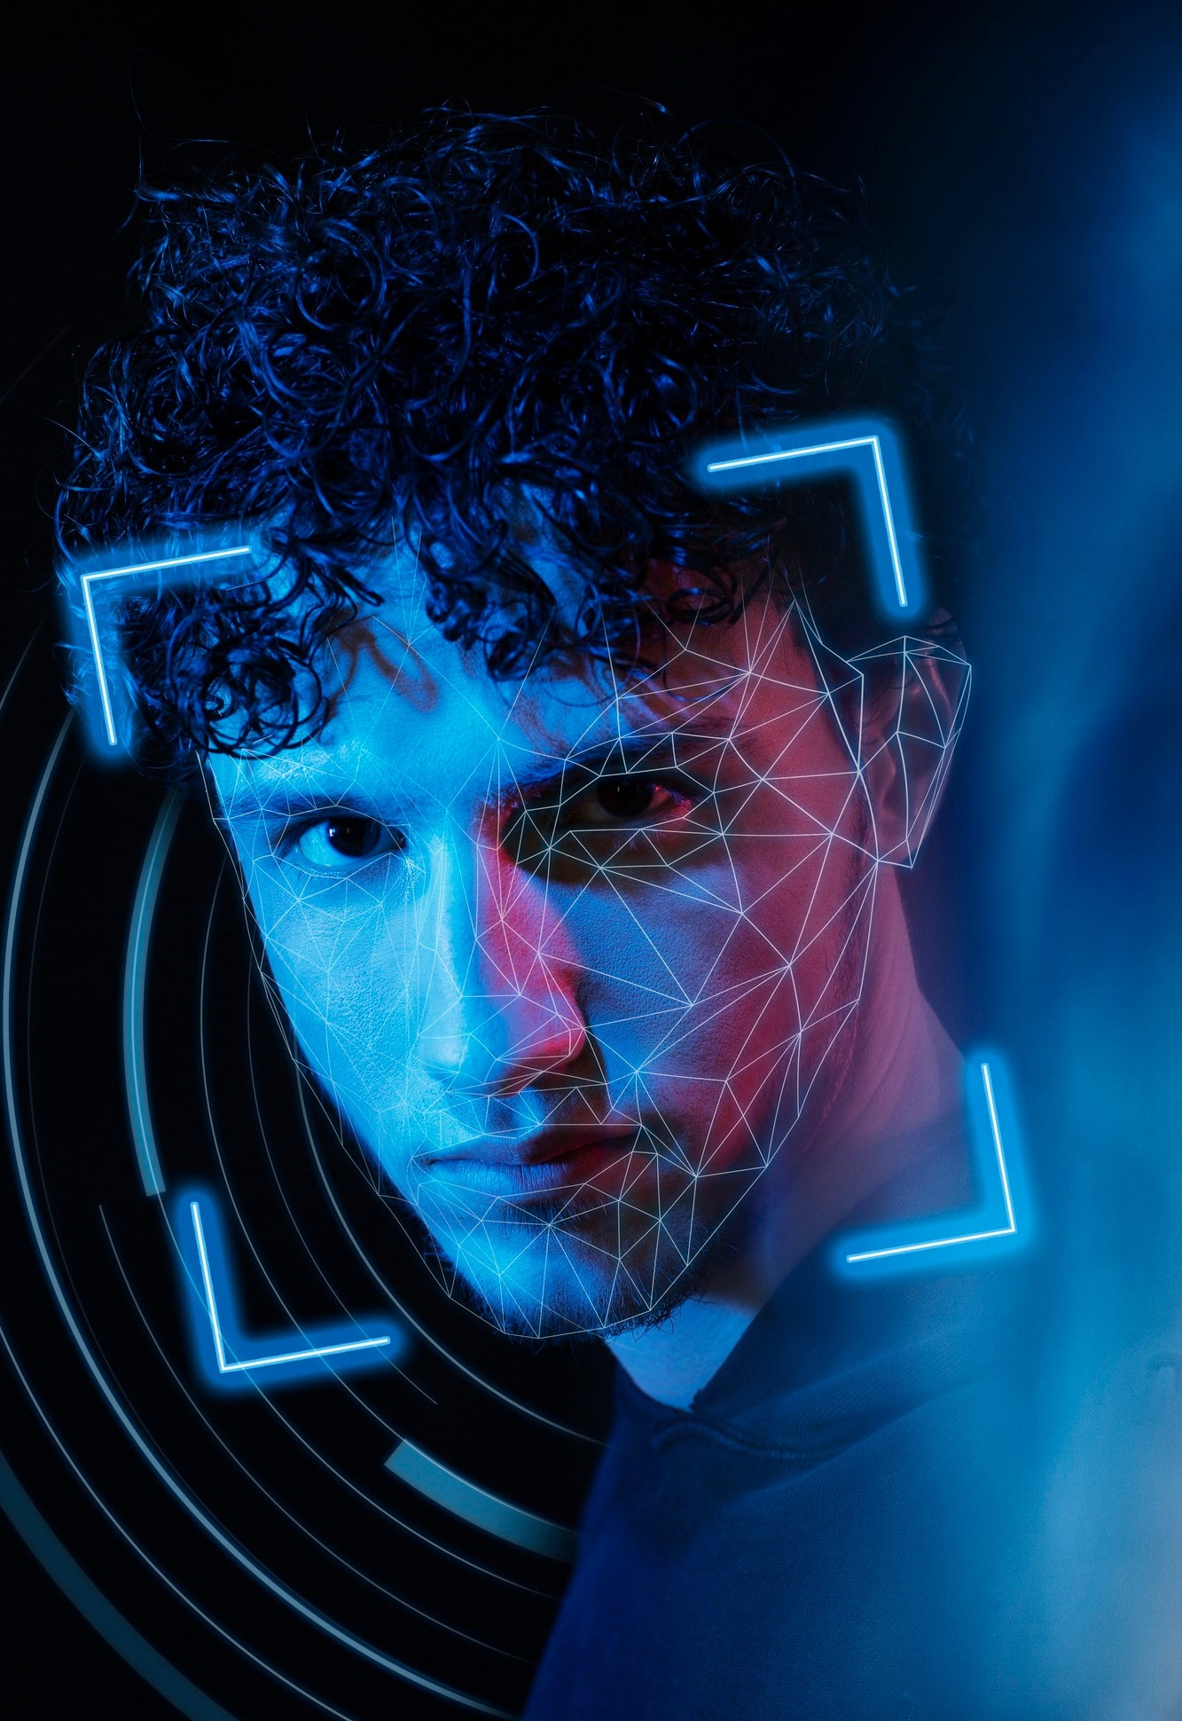


Introduction
This presentation explores the potential of in advancing technology. We will delve into the latest developments and their implications for security and privacy. Join us as we examine the future of facial recognition.

Slide 4



Understanding Generative AI
Generative AI refers to a class of systems that create data, such as images or music, through a process
similar to human creativity. By leveraging
these systems can generate highly realistic and detailed content.
,

Slide 5

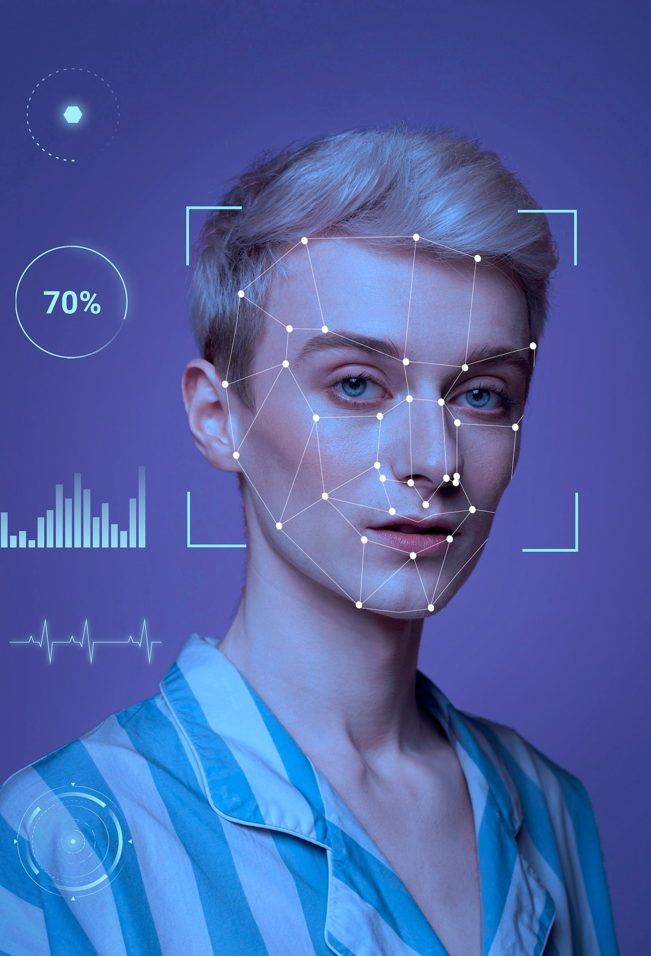

Challenges in Facial Recognition
Despite advancements, traditional facial recognition systems face challenges in accurately identifying individuals under varying conditions,
such as changes in and
These limitations have spurred the need for more robust solutions.
.

Slide 6
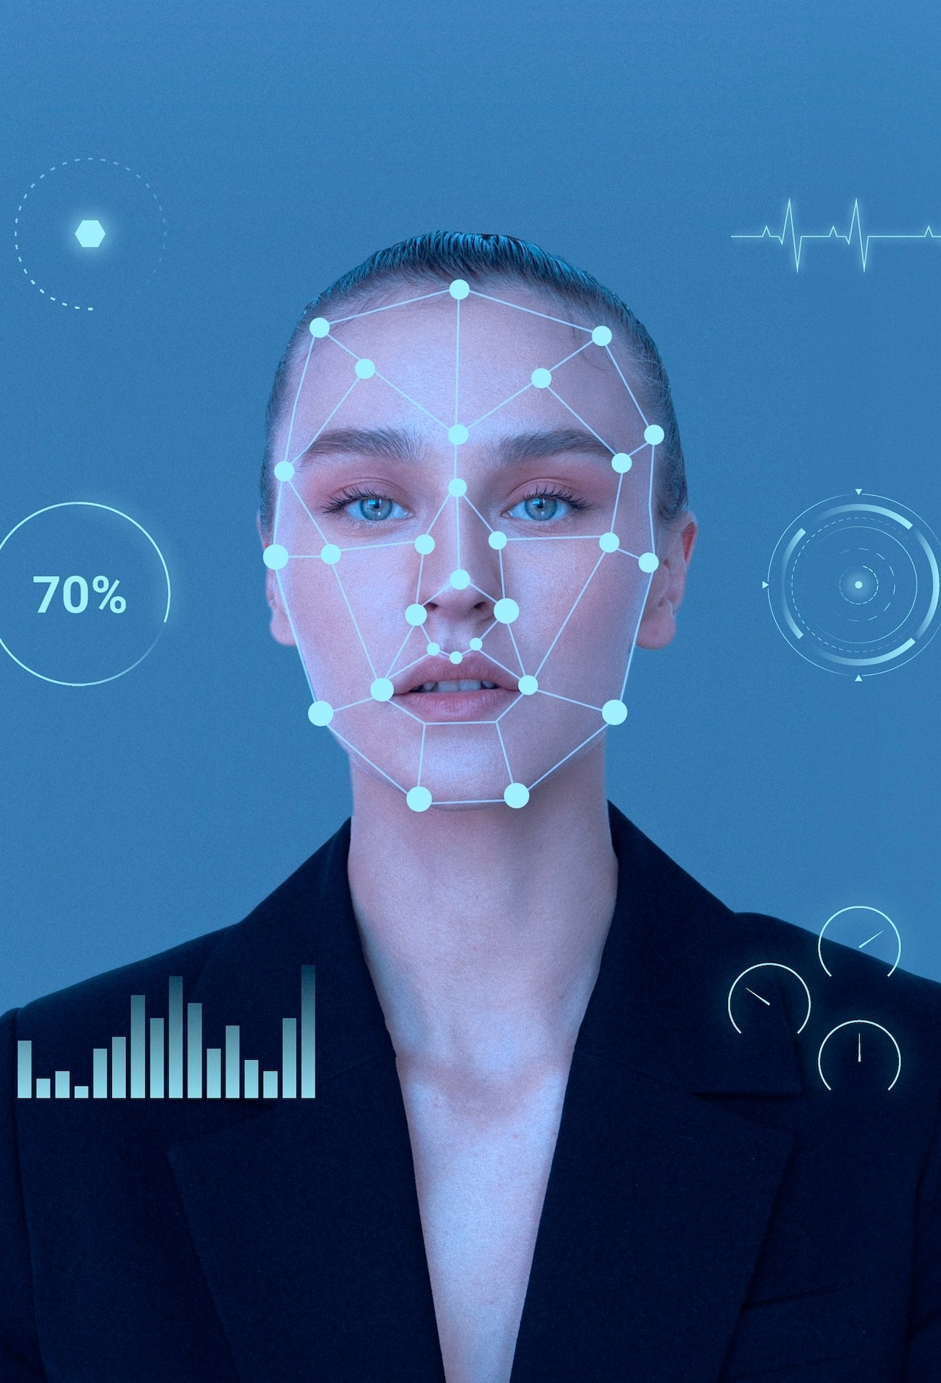
Benefits of Generative AI in Facial Recognition
Generative AI can enhance facial recognition by generating synthetic data to train models, enabling them to learn from a more diverse set of facial features and conditions. This approach holds promise for improving recognition accuracy and reducing bias.

Slide 7




Ethical Considerations
As we embrace the potential of generative AI in facial recognition, it is crucial to address
. Ensuring and
mitigating potential misuse are essential aspects that demand careful attention and regulation.

Slide 8


In conclusion, the integration of generative AI has the potential to significantly advance facial recognition technology, oﬀering improved accuracy and robustness. However, it is imperative to navigate the ethical and privacy challenges to ensure responsible and beneficial implementation.

Slide 9



